Slide 1
Tiverton Academy
SEND
Information Report

Slide 2
Menu
Open and honest communication
Meet our team
Appropriate and effective teaching and learning
A partnership approach

Slide 3
Open and honest communication
How do I speak to the SENCO, if I have a concern about my child?
How will my child’s progress be reviewed and when will I be invited into school to discuss this?
Will my child be able to give their views?
How will the SENCO ensure the necessary people know about my child’s needs?
If my child needs extra support, will I always be spoken to about it?
Will the information that needs to be shared with me, be made clear and easy to understand?
Menu

Slide 4
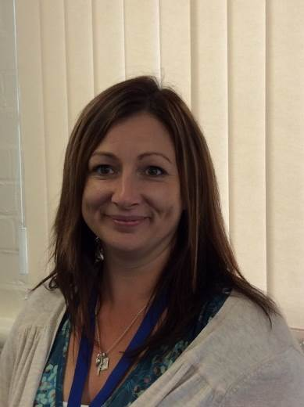
Meet our team
Mrs. Tennant Miss Mason
Special Educational Needs
Coordinator
Senior Learning Mentor
Menu

Slide 5
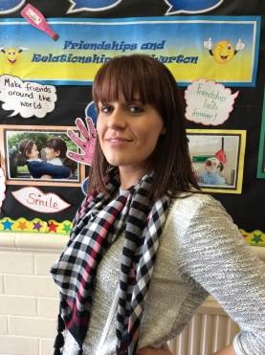
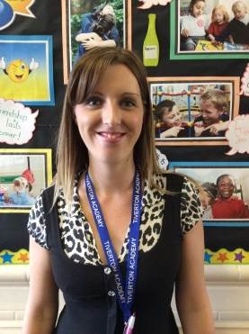
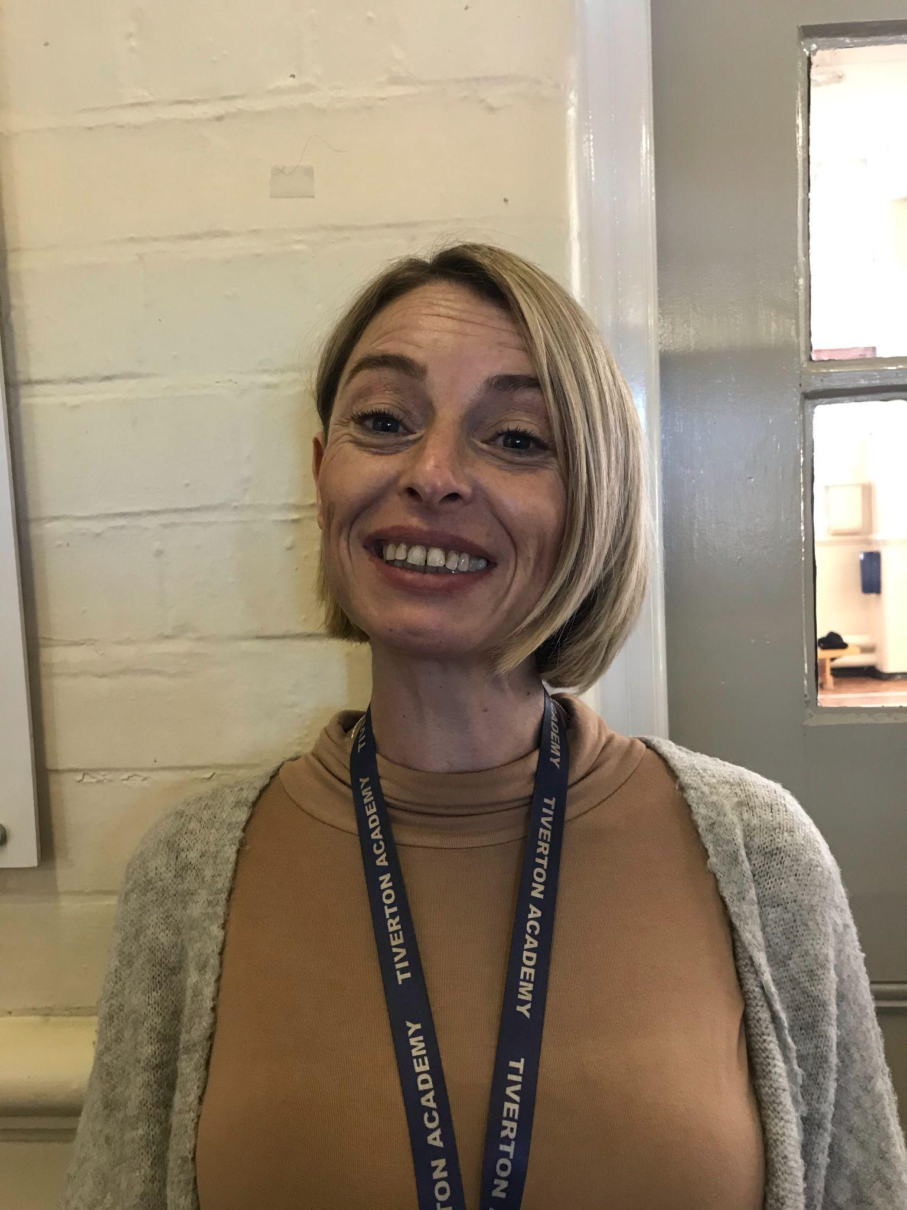
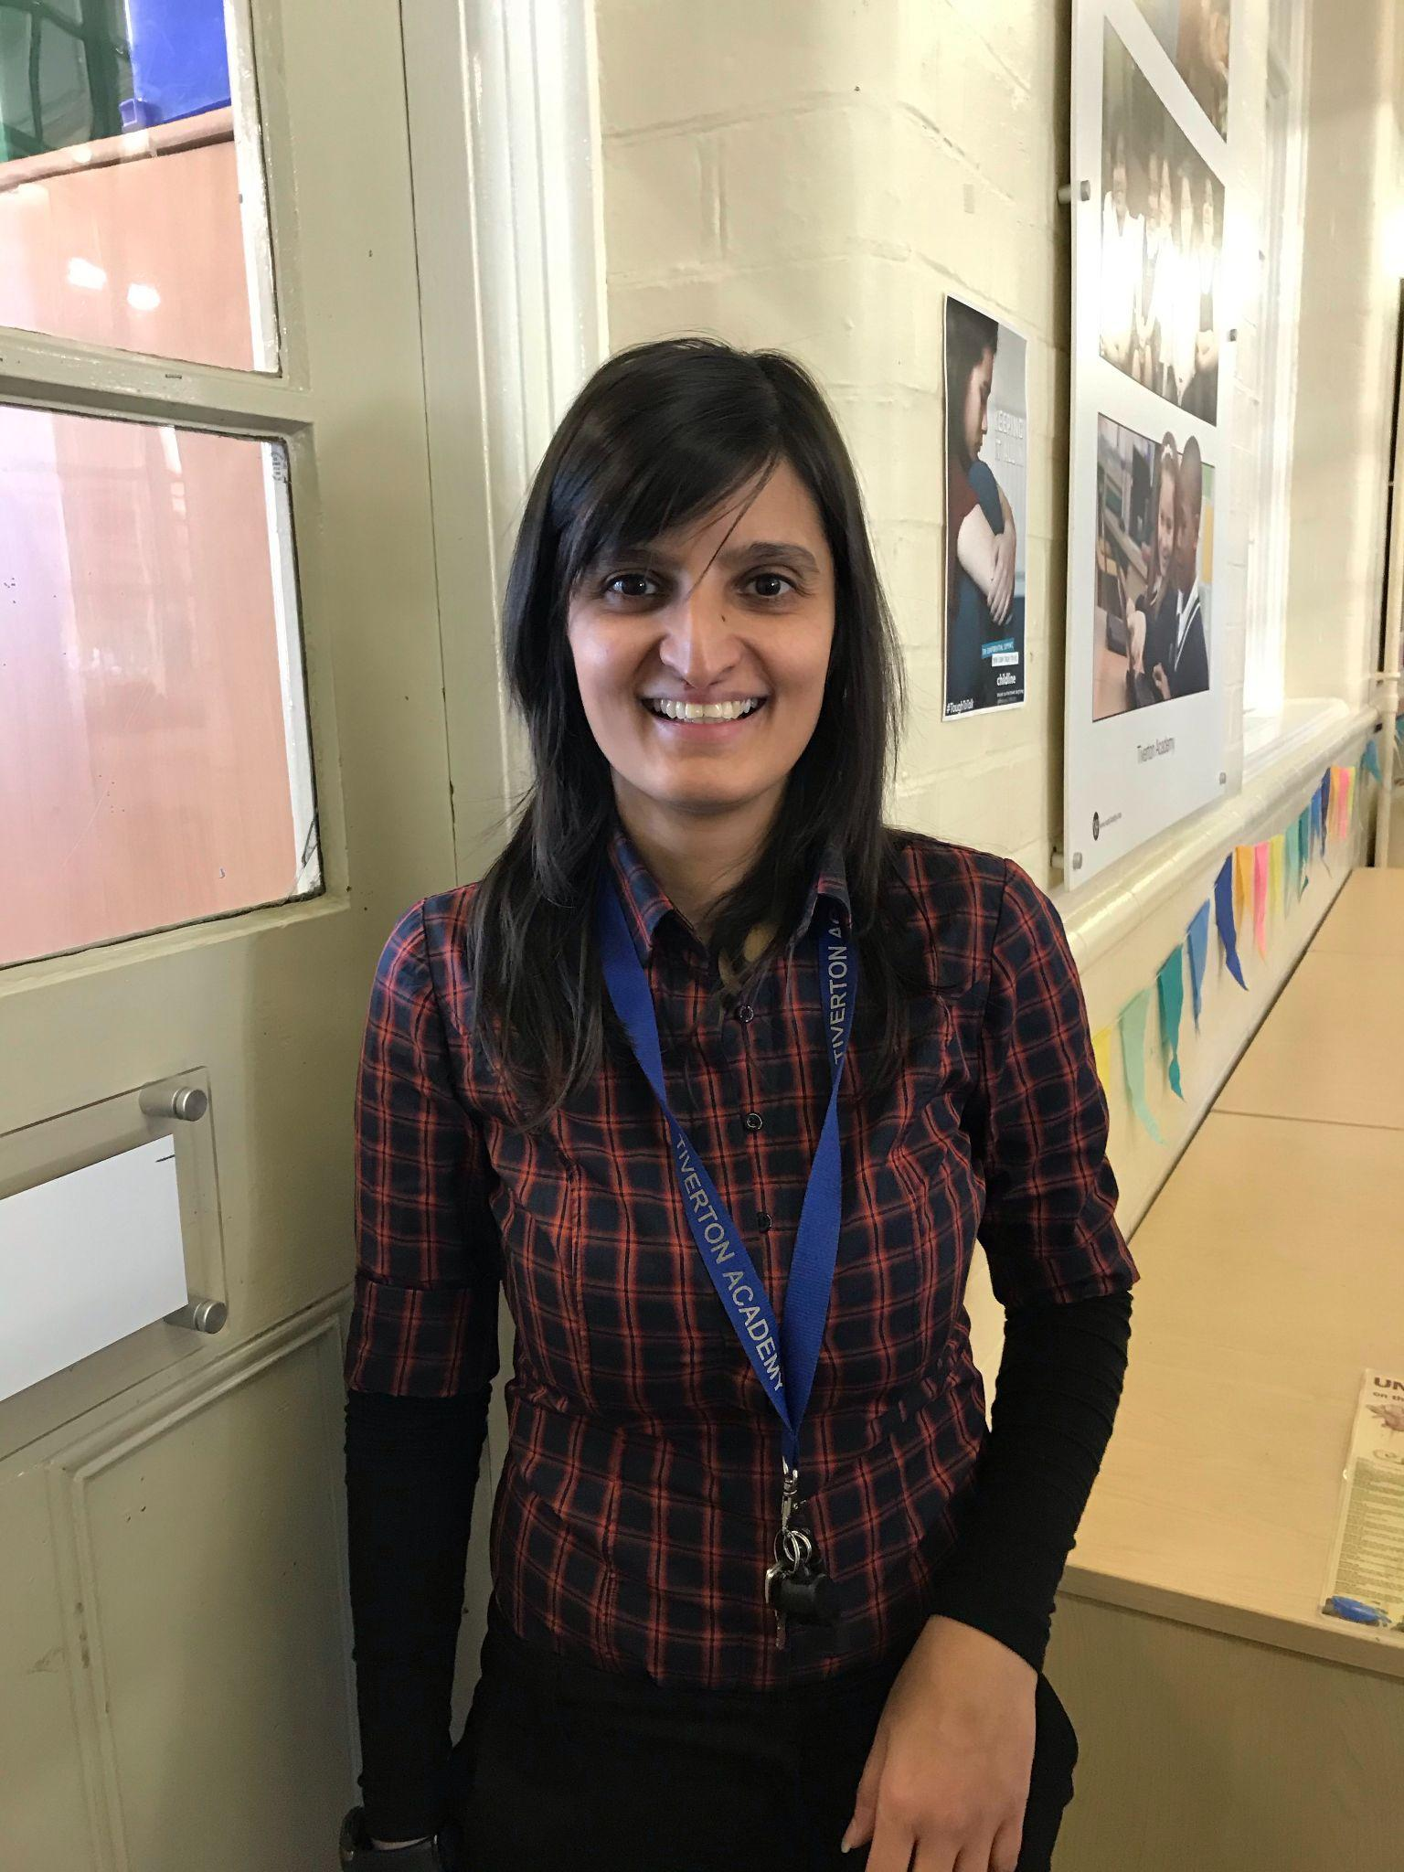
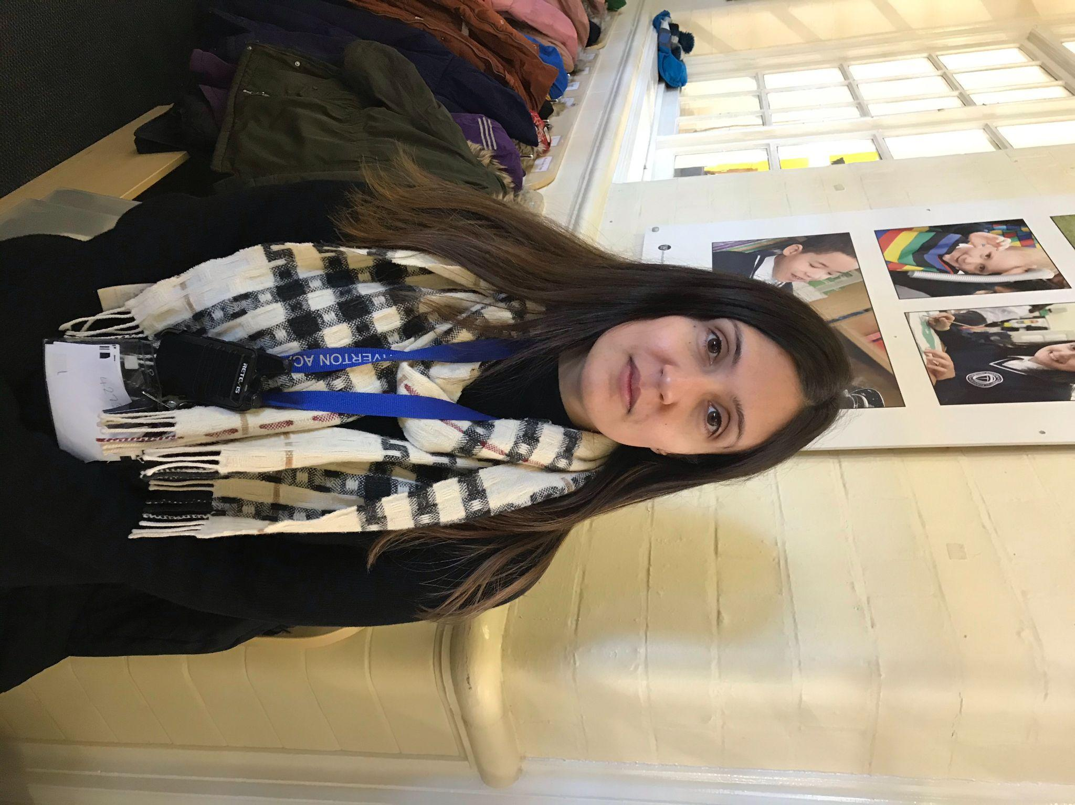
Learning Support Staff
Miss McCullogh
Mrs Perks
Mrs Edwards
Mrs Ward
Mrs Francis
Mrs Zahar
Miss Ali

Slide 6
How do I speak to the SENCO, if I have a concern about my child?
Mrs Tennant is our SPECIAL EDUCATIONAL NEEDS co-ordinator and Pastoral Manager.
If you would like to talk to our SENCO then you can phone the school office and arrange a meeting or Mrs Tennant is available at Parental Consultations which take place once a term.
The phone number to contact the office is 0121 464 3125.
Menu

Slide 7
How will my child’s progress be reviewed and when will I be invited into school to discuss this?
Your child’s progress is reviewed termly through discussions with the class teacher, support staff and SENCO.
Your child’s individual targets relating to their specific area of need will be focused on to see if the provision and strategies being used are ensuring they are making sufficient progress.
You will be invited in to discuss this during Parents Evenings but you can talk to the SENCO or Class Teacher at any point during the year to discuss your Child’s education.
Menu

Slide 8
At Tiverton Academy we believe in parents as partners and so we are always approachable as we want our parents to feel involved in the education of their child. This is done in a variety of ways including:
Regular meetings with class teacher, (support staff where relevant) and the SENCo.
Target setting so parents can see what their child is working on next.
Home/school books for some children to inform parents of about the child’s day.
Home reading logs.
Information on the school website.
Parents’ evenings.
INSPIRE workshops.
Parent drop-ins/coffee mornings.
Signposting to parent groups.
News Letters to all families containing all the current school news and information.
Class blogs
Twitter
Instagram
Menu

Slide 9
Will my child be able to give their views?
How your child views their education and sees themselves as a learner is a vital component in the assessment, review and plan cycle. They are at the centre of our work and so ensure that all pupils have a voice.
Where appropriate, pupils are invited to attend review meetings alongside staff and parents to enable them to contribute fully to the identification of the areas needing support.
Our Senior Learning Mentor also has regular discussions with pupils around their learning and these views are fed into the reviews.
Menu

Slide 10
How will the SENCO ensure the necessary people know about my child’s needs?
Tiverton Academy works in partnership with a wide range of specialist support services which are available to support your child if needed.
These include Pupil and School Support Service (PSS), Communication and Autism Team (CAT), Educational Psychologists, Speech and Language Therapists (SALT), Child Development Centre (CDC), Occupational Therapy
Menu

Slide 11
If my child needs extra support, will I always be spoken to about it?
Your child’s class teacher will be in regular contact with you about your child’s progress through formal parent’s evenings and informal discussions as necessary.
If they feel that extra support would be helpful to enable your child to make progress, then they will contact you to discuss this and inform you of the type of intervention your child may need.

Slide 12
Will the information that needs to be shared with me, be made clear and easy to understand?
All the necessary information about your child’s special educational needs will be written in a way that is clear and easy to understand.
We will speak to you about any reports written by ourselves or outside agencies to make sure that you understand all the information presented in it.
All information on our website can be accessed in the majority of languages using google translate.
Menu

Slide 13
Appropriate and effective teaching and learning
How will the school ensure that parents and children with additional needs are fully included in all school activities?
How will the school provide good teaching for my child and extra support when needed?
How are staff trained to support the needs of my child?
How is work differentiated at the right level to make sure my child makes good progress?
What types of learning resources are available for my child?
What support is available if my child needs support with managing behaviour or dealing with social situations?
What resources does the school offer if my child has significant social and/or communication needs?
Menu

Slide 14
How will the school ensure that parents and children with additional needs are fully included in all school activities?
Tiverton Academy ensures that all children, including those with special educational needs and / or disabilities, receive a broad and balanced curriculum.
As part of our open door policy, parents can talk to school at any time about any activities that happen at school.
The school liaises with a number of outside agencies who support us in being able to make all activities that we run accessible to all. These include the hearing impairment team, the visual impairment team, the communication and autism team, Victoria Outreach for physical impairment etc.
Menu

Slide 15
How will the school provide good teaching for my child and extra support when needed?
Tiverton Academy believes that high quality first teaching is essential for all children, including those who have special educational needs and has robust systems in place to monitor the standards of teaching across the school.
All our staff are highly effective at differentiating the curriculum for the needs of all the children in their class.
Extra support staff are available to assist the teaching in providing the appropriate level of support needed.
As well as the high quality differentiated teaching that our children receive in class, children on the special needs register will be working towards specific targets using an Individual Target Plan (ITP) in order to achieve their own recognised outcomes. These ITPs are used as an ongoing planning and assessment tool to enable the pupil to make rapid progress against the incremental targets set for speaking and listening, reading and writing. The Class Teacher and SENCO will review them termly with the parents and adjust the targets as appropriate. The plans will include details of specific programmes / interventions that each child is receiving as part of their SEN provision. Both parents and children will be involved in the review process.
Staff are skilled at using a range of teaching strategies which cater for different types of learners.
We are an inclusive school and wherever possible children are taught alongside their peers in clear differentiated groups. Children are taught in a range of groups which include whole class teaching, small group work and individual teaching. Individual support is used where needed but we try to make all our children independent learners.

Slide 16
The Graduated Approach

Slide 17
Tiverton Academy follows the National Curriculum 2014 and Foundation Stage Curriculum. Where children need a personalised curriculum this is planned by class teachers in liaison with the school SENCo and, where needed, with relevant outside agencies. This personalised curriculum will be in response to the requirements set out in a child’s statement of Education Needs (Education Health Care Plan)
Pupils with SEND who require more detailed and specific short and long term targets with a personlised curriculum for up to 2 years will have this set out in a Special Educational Needs Support Provision Plan (SSPP)
Depending on a child’s specific needs, the curriculum may need adapting, or specialist resources and / or equipment may be needed in order to access this. The school will endeavour to make sure that these adaptions are made and communicated to parents.
As well as Teaching Staff ,Teaching Assistants and a Senior Learning Mentor the school also commissions a music therapist who works with children who require emotional support in order that this does not become a barrier to their learning.
Menu

Slide 18
How are staff trained to support the needs of my child?
As part of the school’s continual professional development programme, all staff receive training on different areas of SEN and on identifying and supporting these additional needs in class.
In addition to this, the SENCOs will give specific training to staff on the individual needs of the children in their class.
Where needed, the school can access outside agencies to deliver training on a specific area of need. This may include the ADHD team, the Communication and Autism Team, the School Nurse etc.
Menu

Slide 19
How is work differentiated at the right level to make sure my child makes good progress?
Staff at Tiverton Academy are skilled in differentiating work to meet the needs of all pupil’s in their class.
As well as the high quality differentiated teaching that our children receive in class, children on the special needs register will be working towards specific targets. These will be reviewed termly and will include details of specific programmes / interventions that each child is receiving as part of their SEN provision.
Where a child has an Education Health Care Plan or SEND Support Provision Plan, the school will ensure that the provision that is set down for that child is planned into their timetable with the appropriate level of support.
The school uses a range of assessment methods which ensure that our children make the appropriate rate of progress. All children, including those with special educational needs, are set individual targets against which they are tracked. Where a child is not making adequate progress, intervention is put in place to help them to catch up.
Menu

Slide 20
What types of learning resources are available for my child?
Tiverton Academy uses a wide variety of resources to support children with their specific special education need. These include: visual timetables, feelings scales, specific Literacy and Numeracy intervention resources, timers, ear defenders, specialised writing equipment, sensory bags and sensory equipment, mind mapping resources, working memory programmes etc.
We us a range of ICT hardware and software to help pupils engage with subjects they find difficult; practice basic skills; become independent learners
Menu

Slide 21
What support is available if my child needs support with managing behaviour or dealing with social situations?
Tiverton Academy have support from specialist teachers/support staff for accessing the curriculum and extra work on SEND related needs (speech, language and communication; hearing impairment; visual impairment; behaviour related needs; severe learning difficulties; autism)
The School can use the services of an Educational Psychologist to give advice and support where needed.
The School can get support from speech and language therapy (SALT) to train our staff; advise on strategies and programmes; we refer pupils for assessment if we believe they need a period of therapy.
The School can refer to the occupational therapy service if we feel that support is needed in this area.
The School also employs a Senior Learning Mentor who works with children on resolving behaviour issues and / or social issues.
The School can access regular emotional wellbeing support from the Music Therapist who works in school one day a week
Menu

Slide 22
What resources does the school offer if my child has significant social and/or communication needs?
Tiverton Academy employs a Senior Learning Mentor who works with children on resolving behaviour issues and / or social issues. Our Learning Mentor has a range of resources to help support these children.
The school liaises with outside agencies such as the Communication and Autism Team and Speech and Language services who suggest suitable resource to help children with significant social and / or communication needs.

Slide 23
A partnership approach
How will Tiverton work with me to identify my child’s needs?
How will the SENCO ask for my permission to involve other professionals to work with my child?
How will I be involved in all decisions and have my views listened to?
How will my child be involved in decisions about their learning?
How will I be given support in contacting organisations who can give me advice and support?
How can I find the Local Authority's Local Offer?
Menu

Slide 24
How will Tiverton work with me to identify my child’s needs?
Tiverton Academy has an open door policy to parents ensuring we are always approachable so parents feel involved in the education of their child.
In addition our school aims to regularly involve parents in the education of their child through a variety of ways including:
Initial meeting to discuss concerns
Parents evenings
Regular meetings with SENCO, class teacher, key worker
Target setting so parents can see what their child is working on
Home / School diaries to inform parents of important information and teachers of key things that have happened at home
Workshops to support children with their learning
Menu

Slide 25
How will the SENCO ask for my permission to involve other professionals to work with my child?
If your child requires extra support from an outside agency or if advice is needed the SENCO will discuss this with you.
All information about the service and how it will benefit your child will be made available.
Some services require parental consent so you may be asked for a signature to agree to the agency being involved e.g. Educational Psychology Service, Pupil and School Support, Communication and Autism Team
Menu

Slide 26
How will I be involved in all decisions and have my views listened to?
Parents will be informed every step of the way about their child’s provision.
This will be done through parents evening consultations and target review meetings where your views about the support and interventions your child is receiving will be sought.
Parents will be invited into informal drop in sessions where we will ask your views about the SEN provision in school.
Our school and TEFAT take complaints seriously and will act upon these on an individual basis. Please see the complaints procedure policy for more information.
Menu

Slide 27
How will my child be involved in decisions about their learning?
In the Early Years Foundation Stage we talk to children about their targets and what we are working on.
In Key Stage 1 and 2 the children are encouraged to take a more active role in the review process by contributing more detailed responses.
We aim to involve all children in making decisions about their education.
We use a variety of strategies to support them including:
Involving the pupil in setting their own targets
Self assessment at the beginning and end of learning
Child’s target review meeting
One to one support when needed
Menu

Slide 28
How will I be given support in contacting organisations who can give me advice and support?
Our Community Council member who is responsible for SEND is Jem Shuttleworth
The SENCOs can signpost parents to a wide range of services that can support families which include Forward Thinking Birmingham, Communication and Autism team, ADHD team, Pupil and School Support Service, Educational Psychology Service, Special Educational Needs Assessment and Review team, Speech and Language Therapy, SENDIASS, Children’s Services
Menu

Slide 29
The Birmingham Local Offer
The Birmingham Local Authority’s
Local Offer can be found at:
https://www.localofferbirmingham.co.uk/
Menu

